Slide 1
Swin Transformer:
Hierarchical Vision Transformer using Shifted Windows
Submitted on 25 Mar 2021
Authors {Ze Liu, Yutong Lin, Yue Cao, Han Hu, Yixuan Wei, Zheng Zhang, Stephen Lin and Baining Guo}@microsoft.com
Presentation by Shua Friedman, JCT

Slide 2
Introduction

Slide 3
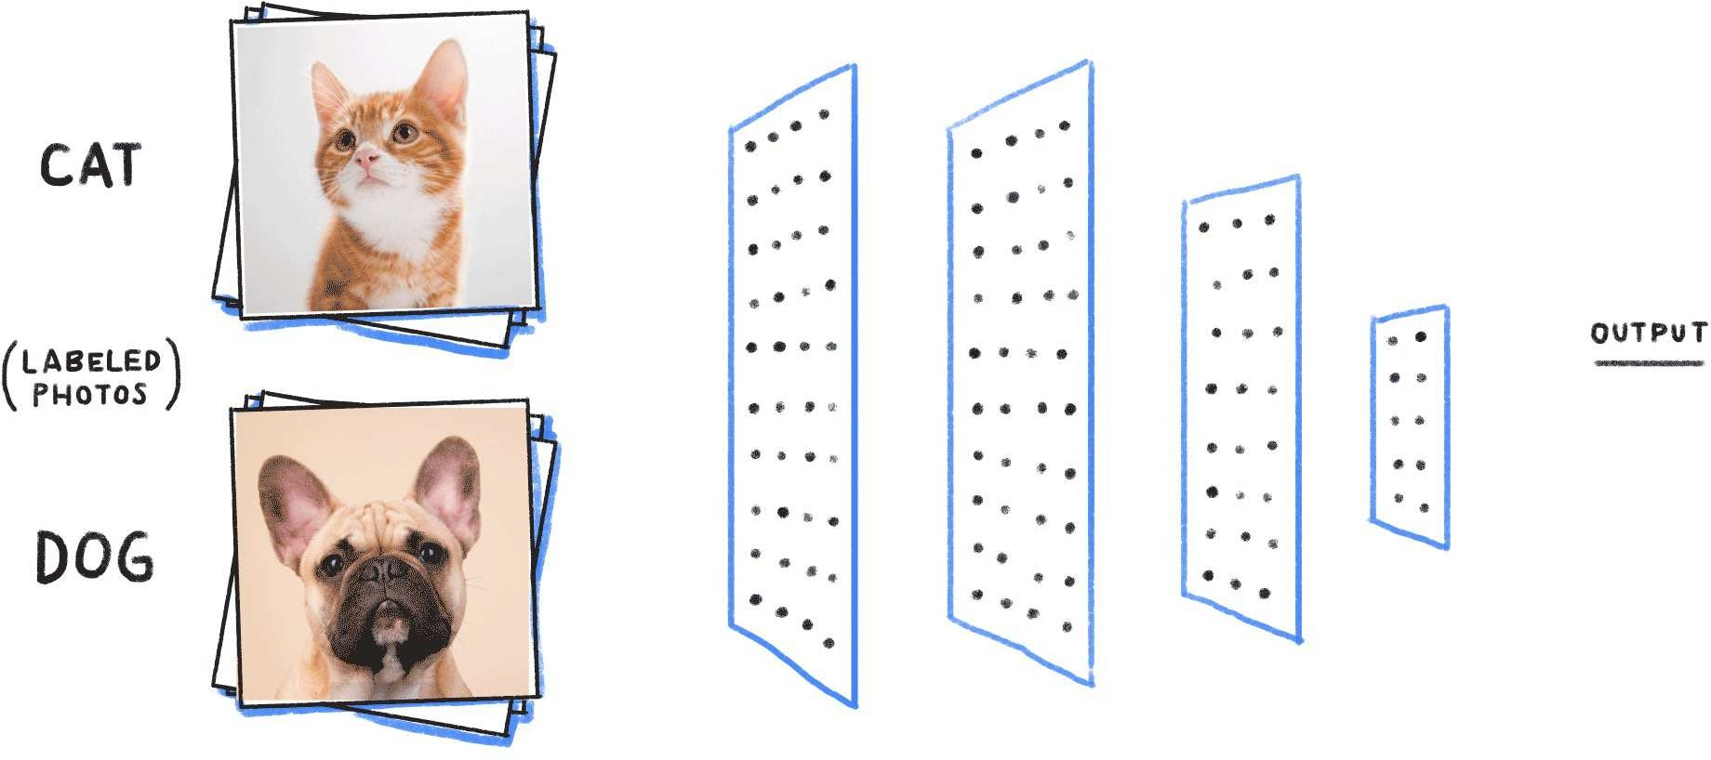
Transformers are Really Great.
Swin Transformer
CNNs, are very localized. They don’t have the spatial information necessary for many tasks like instance recognition because convolutions don't consider distanced-pixels relations.
Transformer’s Self Attention, however, can simultaneously extract all the information we need from the input and its inter-relations.
A
cat sleeping
on couch
A
cat
sleeping
on couch
Transformers
CNNs
6
Notes:
CNNs are indeed more localized, meaning they process information from nearby pixels in an image, but they can struggle with understanding the relationships between distantly spaced pixels. Transformers, on the other hand, are designed to consider the relationships between all parts of the input, regardless of their spatial proximity, making them potentially more effective for tasks like instance recognition.

Slide 4

Self-attention’s Power
Swin Transformer
Self-attention could be seen as a measurement of a specific word's effect on all other words of the same sentence.
This same process can be applied to images, calculating the attention patches of the images and their relations to each other.
A cat sleeping on couch
A cat sleeping on couch
7

Slide 5

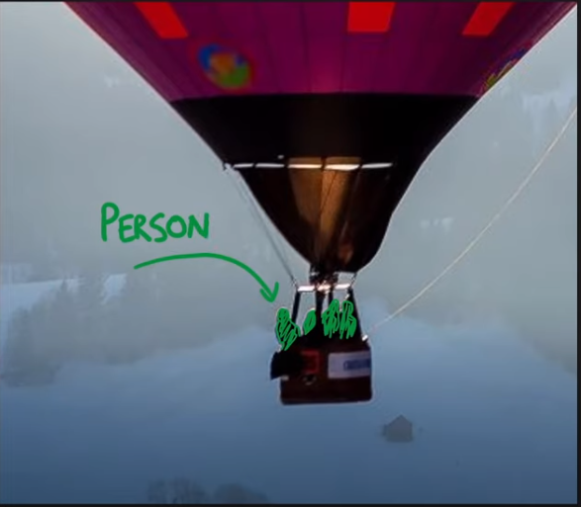




The Problems…
Swin Transformer
1. Limitations of Patches-- Existing Transformer-based models have tokens of a fixed scale. However, in contrast to the word tokens, visual elements can be different in scale (e.g. objects of varying sizes on the scene) -- problems in Image Segmentation
16 X 16 Patches
16 X 16 Patches
Balloon
Person
8
2. Scale -- Self-attention computational complexity is quadratic of the image size, limiting applications in computer vision where high resolution is necessary. So even if we wanted to make the patches smaller…
62500 pixels
3906250000
calculations
250px
Notes:
For example, semantic segmentation requires dense prediction at the pixel level, and this would be intractable for Transformer on high-resolution images.

Slide 6
Swin Transformer

Slide 7
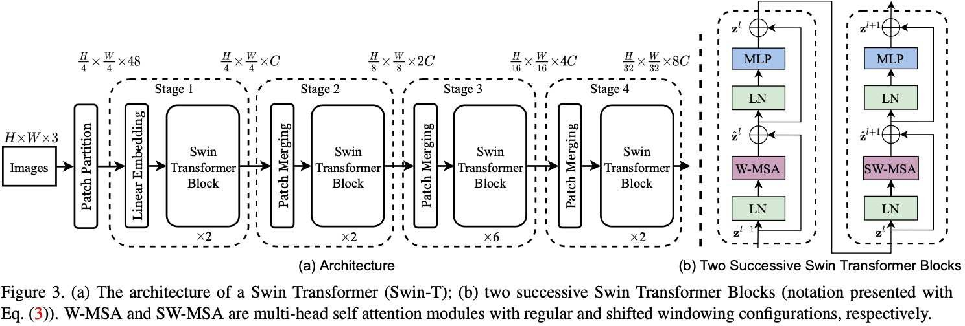
Swin Transformer Architecture-- Two Contributions
Swin Transformer
Patch Merging
Start with small patches at the beginning, merge patches in further layers to create larger patches.
Does this while keeping to Linear Complexity.
Shifted Window Based Self-Attention
Self attention only on small, overlapping windows.
Shifts the windows to allow broader interactions across the image
11
Notes:
Patch Merging: Swin Transformer introduces a hierarchical structure with Patch Merging. It starts by dividing the image into small patches, just like the Vision Transformer (ViT), but then it merges patches in further layers to form larger, "super-patches". This strategy allows the model to capture information at multiple scales.
Shifted Window-based Self-attention: Instead of computing self-attention for the whole image (which would be computationally expensive), or applying self-attention within non-overlapping local windows (which would not capture long-range dependencies), the Swin Transformer introduces a shifted window strategy for self-attention. In this strategy, the positions of the windows are shifted between consecutive layers, allowing each token to interact with a larger context while keeping the computation complexity manageable.

Slide 8
Contribution #1: Patch Merging

Slide 9
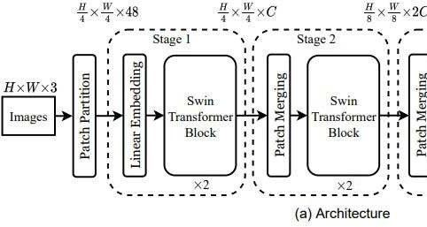
Patch Partition
Swin Transformer
At first, like most computer vision tasks, an RGB image is sent to the network.
This image is split into patches, and each patch is treated as a token (4 X4 X 3 token dimension)
Token A
Token B
Token
Token A
Linear Network
Token A
Token A
Token B
Token C
8
Token C
(4x4x3 tokens)
Dimension = C
(4x4xC channels)
A cat sleeping on couch
Token
8
12
Notes:
The image shape is H x W x 3 (height, width, three channels), on which Swin Transformer uses a patch size of 4 x 4. As such, we have H/4 x W/4 patches, and each patch’s feature dimension is 48 (= 4 x 4 x 3). In stage 1, the linear layer projects the raw-valued features to an arbitrary dimension C.

Slide 10
Patch Merging

Slide 11
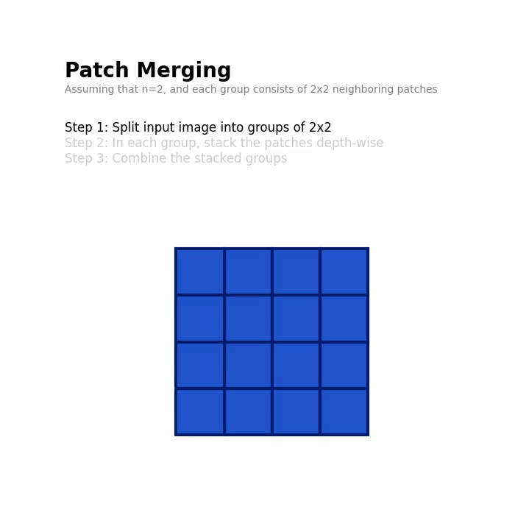
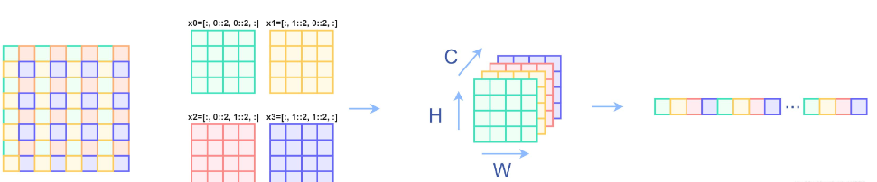
Step 1: Concatenation

Slide 12
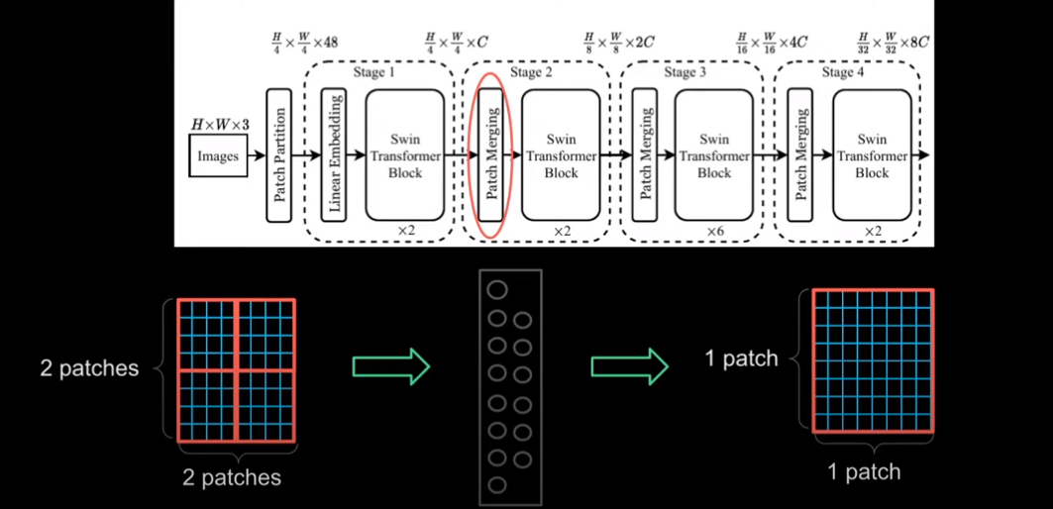
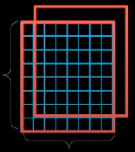
Linear Network
Step 2: Concatenation
Notes:
As we move through the network, we are left with less and less patches. The reduction of the number of patches reduces the computational complexity compared to other networks, becuase we reduce the amount of operations such as self-attention (in Swin, the self-attention is done on each local window. The less number of patches in a window, the less self attention), as well as the amount of feed forward neural networks

Slide 13
H = 224
W = 224
C = 96
(224/8) * (224/8) * 2(96) = 150,528
(224/4) * (224/4) * (96) = 301,056
(224/16) * (224/16) * 4(96) = 75,264

Slide 14
Contribution #2: Swin Blocks and Shifted Window Self Attention

Slide 15
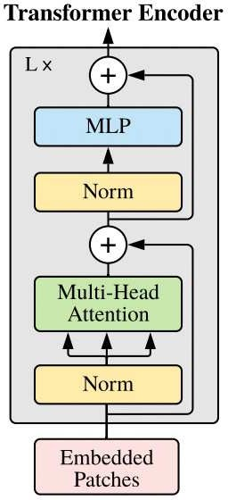
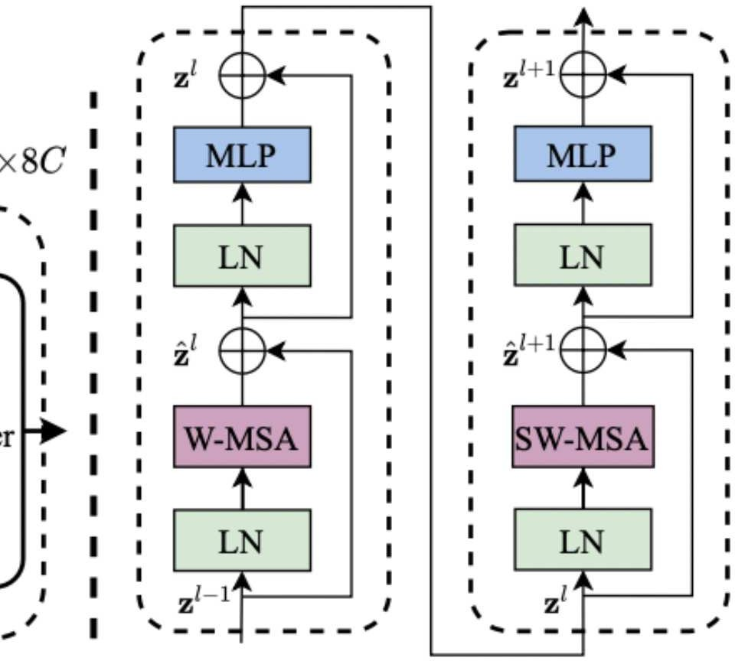
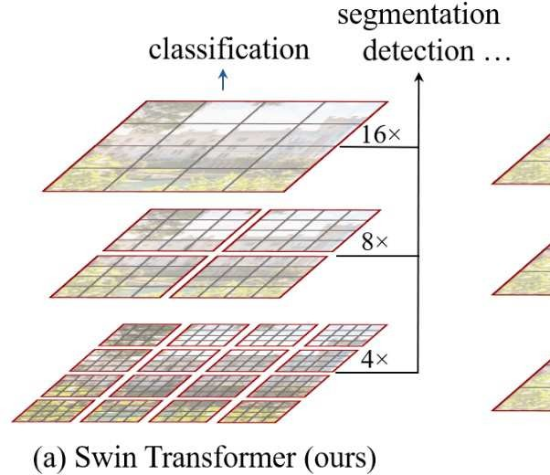
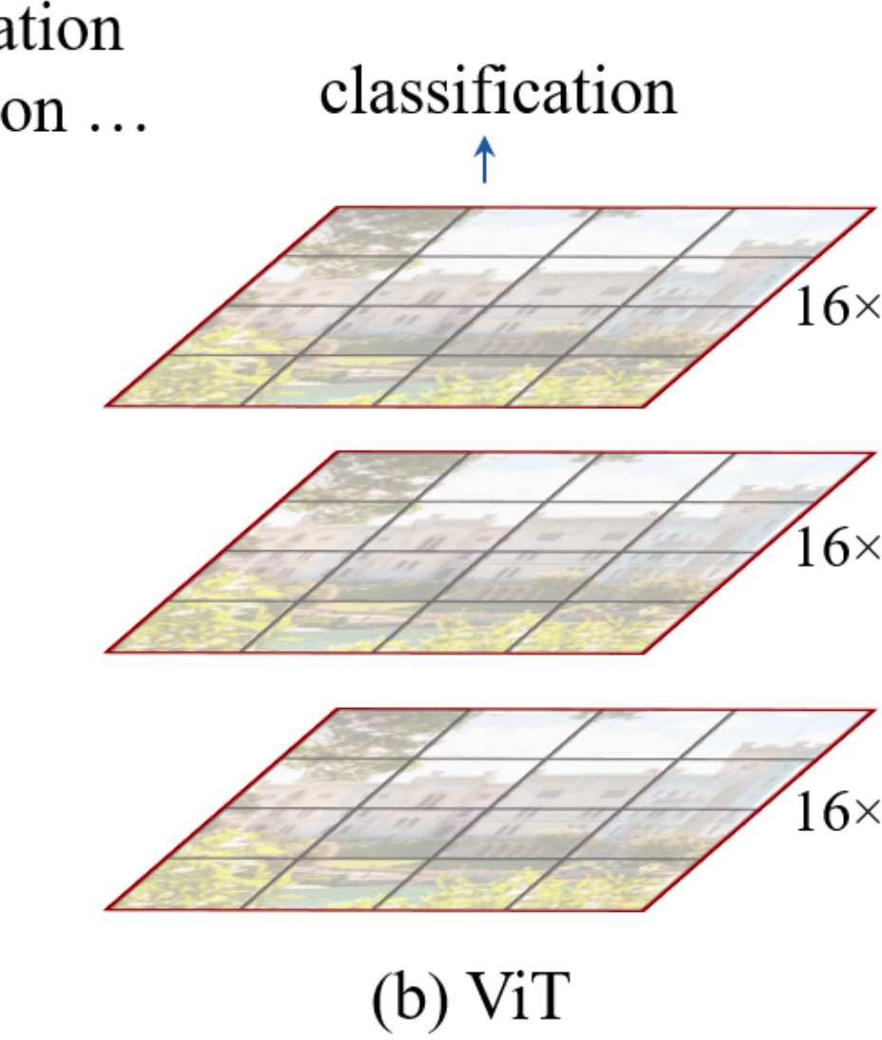
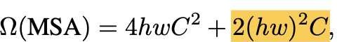
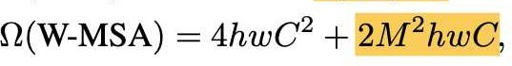
Vision Transformer (ViT) vs Swin Transformer
Swin Transformer
ViT directly applies a Transformer architecture on non-overlapping image patches == Quadratic Complexity
Swin transformer block modifies the multi-header self-attention to solve this…
Vision Transformer (ViT) Complexity: O(N^2)
Swin Transformer
Complexity: O(M*N)
(2) An Image is Worth 16x16 Words: Transformers for Image Recognition at Scale (arXiv:2010.11929)
13
Notes:
the self-attention mechanism of the Transformer has a quadratic computational complexity. This means that the number of computations required grows with the square of the number of tokens. In the context of ViT, this means that the computational cost grows quadratically with the number of image patches (which is proportional to the image size). Therefore, ViT can be computationally expensive for large images.
The Swin Transformer block modifies the multi-head self-attention mechanism to address this issue. Instead of allowing each patch to attend to all other patches (global attention), the Swin Transformer restricts the attention to a local window of patches (local attention). This reduces the computational complexity from quadratic to linear, making the Swin Transformer more efficient and scalable for large images.

Slide 16
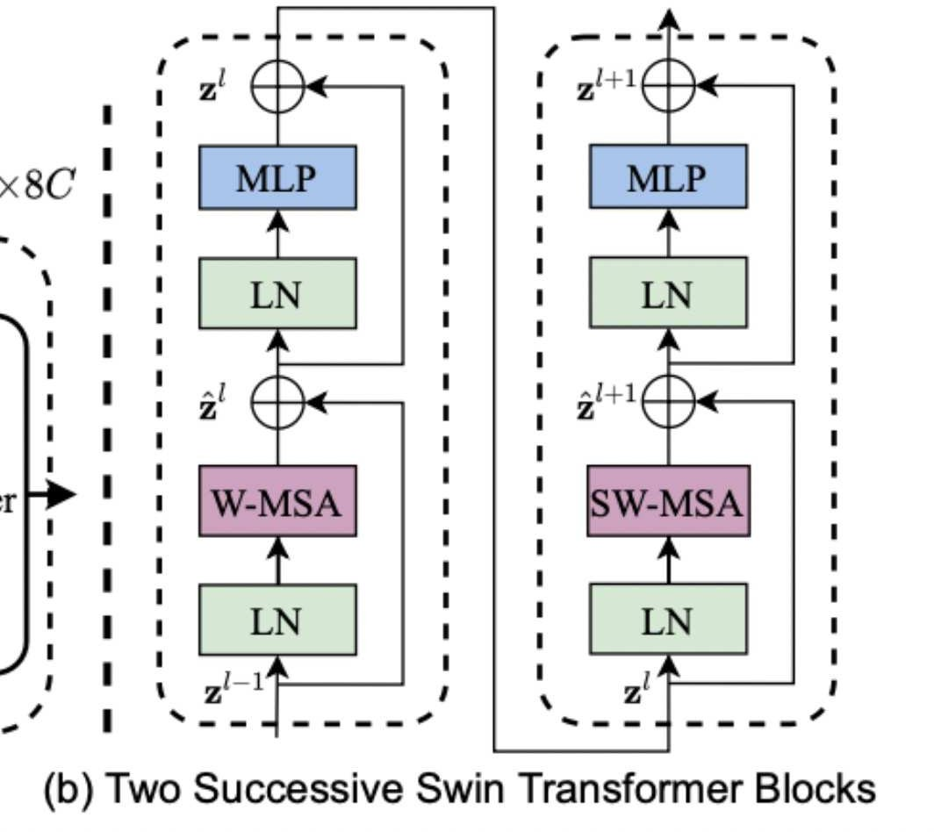
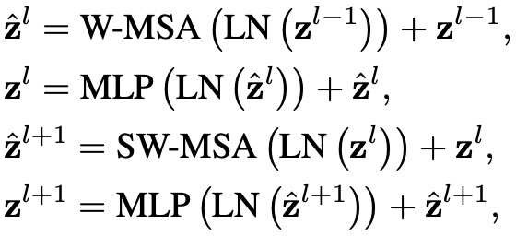
Swin Transformer Blocks
Swin Transformer
W-MSA
The input image is divided into four windows and compute attention for
patches
within the window.
SW-MSA
The approach introduces connections between neighboring non-overlapping windows in the previous layer.
14

Slide 17
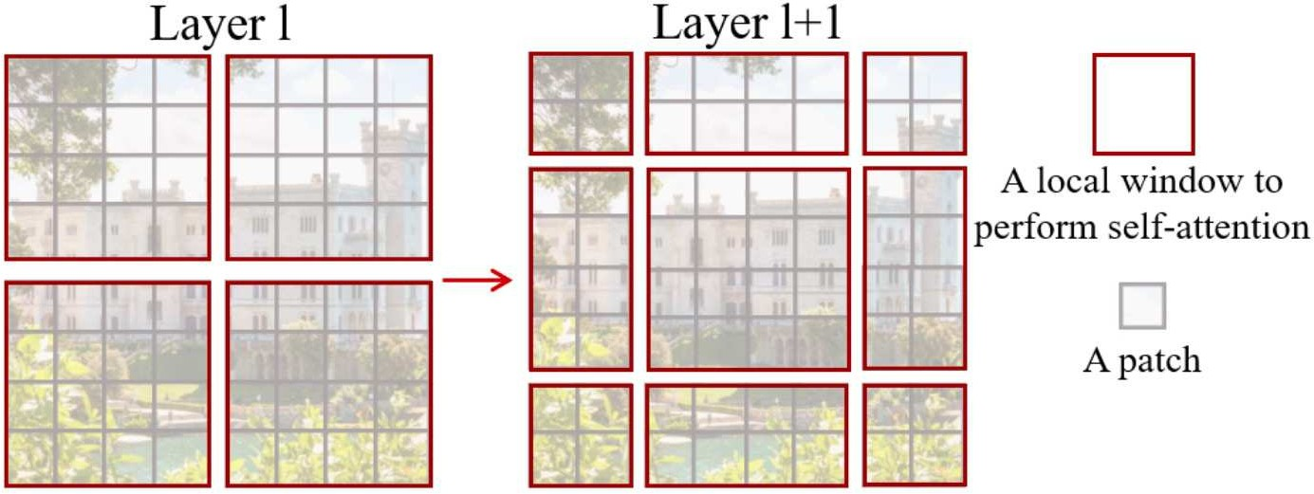
Shifted Window based Self-Attention
Swin Transformer
Self-attention is applied on each patch (window). In layer l (left), a regular window partitioning scheme is adopted, and self-attention is computed within each window.
Then, the windows are shifted, resulting in a new window configuration to apply self-attention again.
This allows the creation of connections between windows while maintaining the computational efficiency of this windowed architecture.
15

Slide 18
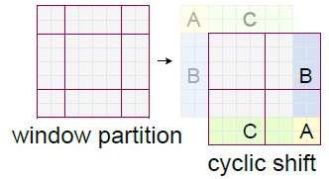
Shifted Window with Cyclic-Shift
Swin Transformer
An issue with shifted window partitioning is that it will result in more windows.
A more efficient batch computation approach is proposed by cyclic-shifting.
With the cyclic-shift, the number of batched windows remains the same as that of regular window partitioning, and thus is also efficient.
Regular downward-right shift creates 9 patches, from 4
Cyclic shift lets us keep 4 patches
16

Slide 19
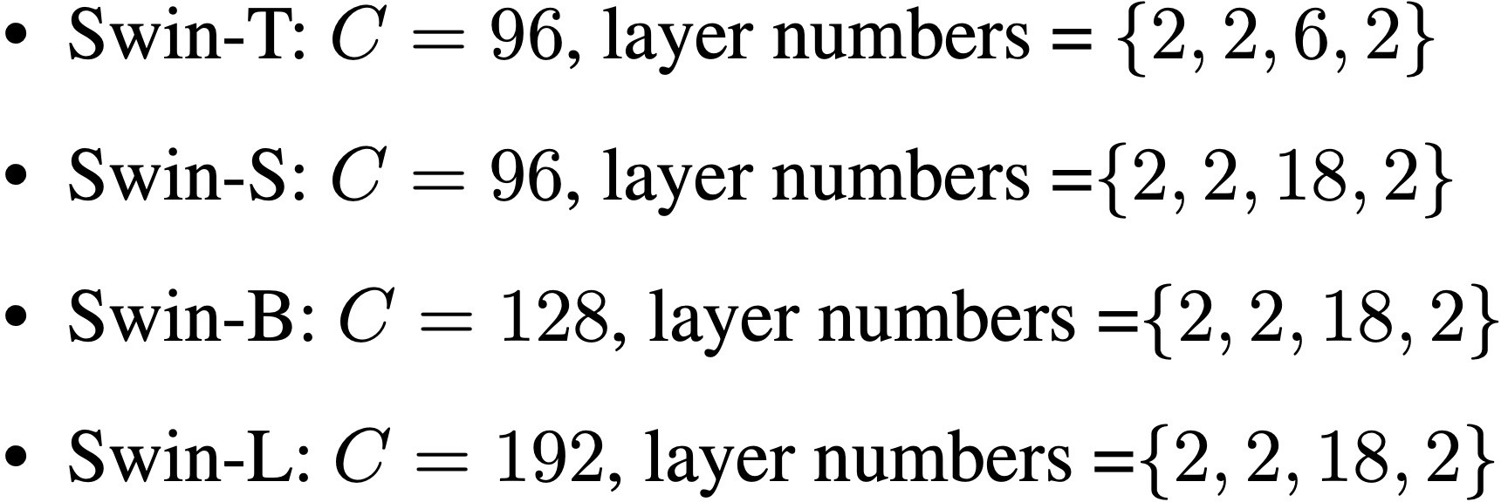
Model Variants
Swin Transformer
The paper also introduce Swin-T, Swin-S and Swin-L, which are versions of about 0.25x, 0.5x and 2x the model size and computational complexity, respectively.
The value of c is from 96 to 128 and 192.
The number of blocks is also changed at each stage from 6 to 18
or keeping them to 2
18

Slide 20
Experiments

Slide 21
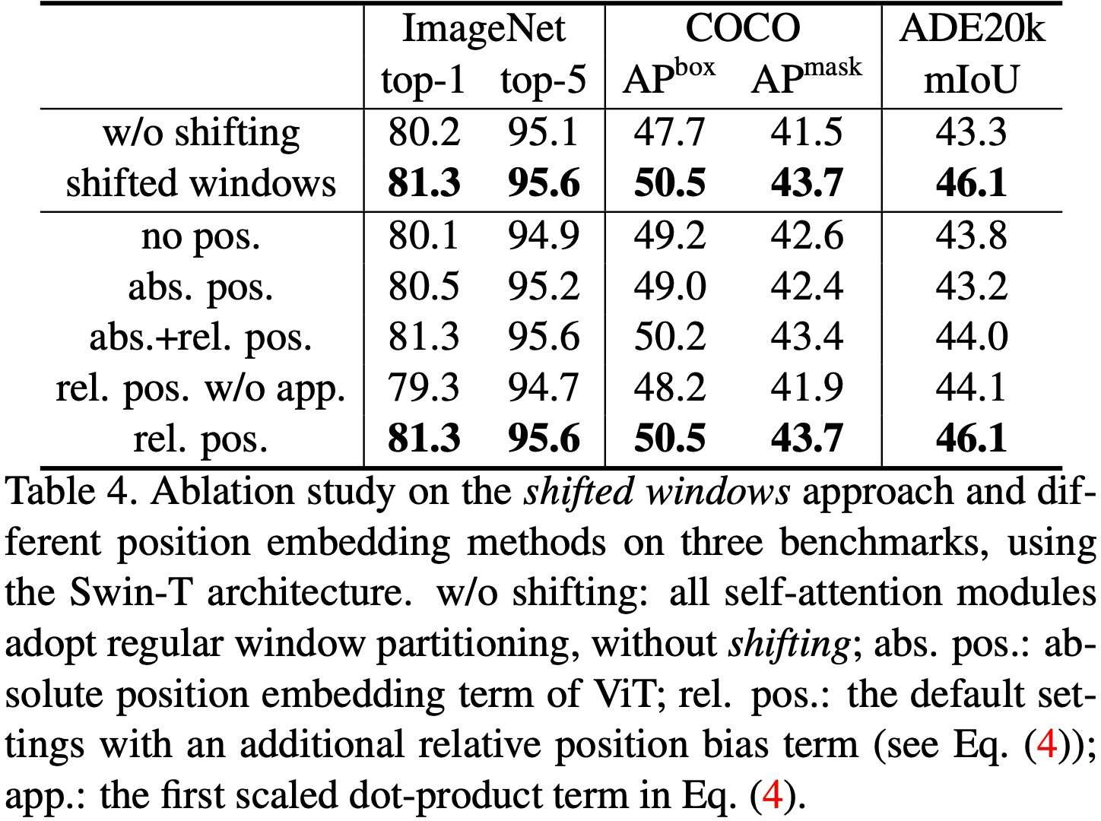
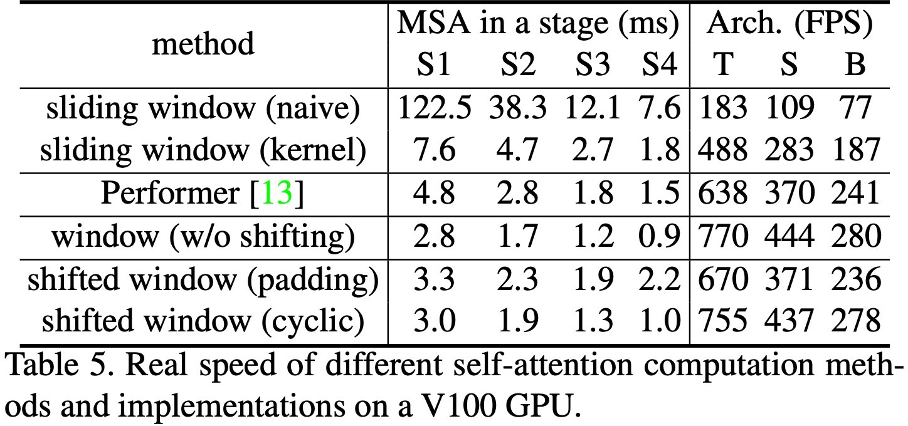
Ablation study
Swin Transformer
The paper show the results of ablation study on shifted window approach. Speed of padding and cyclic method is also compared.
20
Notes:
Swin-T with the shifted window partitioning outperforms the counterpart built on a single window partitioning at each stage by +1.1% top-1 accuracy on ImageNet-1K, +2.8 box AP/+2.2 mask AP on COCO, and +2.8 mIoU on ADE20K.
The cyclic implementation is more hardware efficient than naive padding, particularly for deeper stages. Overall, it brings a 13%, 18% and 18% speed-up on Swin-T, Swin-S and Swin-B, respectively.

Slide 22
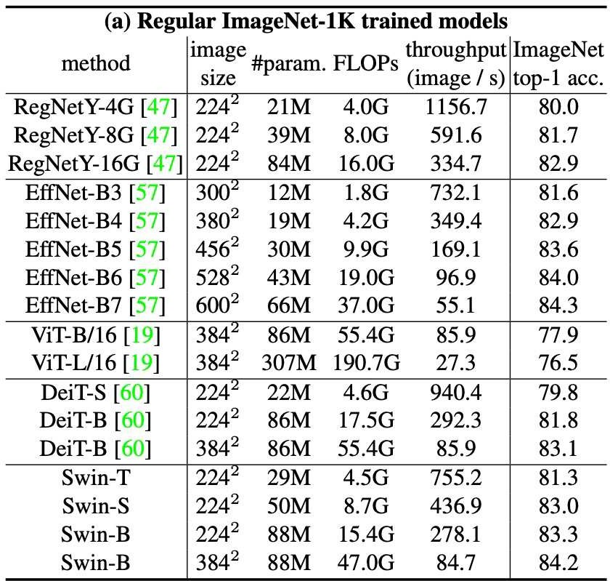
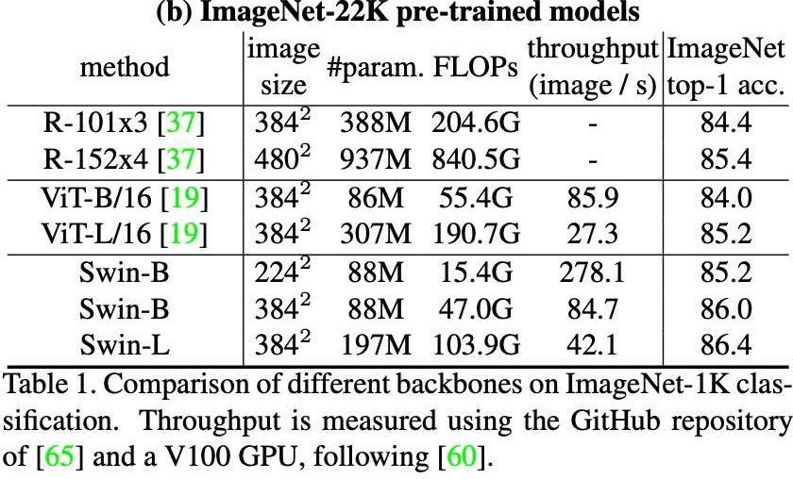
Classification Results
Swin Transformer
Swin-B obtains 2.4% higher than that of ViT with similar inference throughput (84.7 vs. 85.9 images/sec) and slightly lower FLOPs (47.0G vs. 55.4G).
21
Notes:
Swin Transformers noticeably surpass the counterpart DeiT architectures with similar complexities: +1.5% for Swin-T (81.3%) over DeiT-S (79.8%) using 2242 input, and +1.5%/1.4% for Swin-B (83.3%/84.5%) over DeiT-B (81.8%/83.1%) using 224²/384² input, respectively.
Compared with the state-of-the-art ConvNets, i.e. RegNet and EfficientNet, the Swin Transformer achieves a slightly better speed-accuracy trade-off.
For Swin-B, the ImageNet-22K pre-training brings 1.8%~1.9% gains over training on ImageNet-1K from scratch.
Swin Transformer models achieve significantly better speed-accuracy trade-offs: Swin-B obtains 86.4% top-1 accuracy, which is 2.4% higher than that of ViT with similar inference throughput (84.7 vs. 85.9 images/sec) and slightly lower FLOPs (47.0G vs. 55.4G).
The larger Swin-L model achieves 87.3% top-1 accuracy, +0.9% better than that of the Swin-B model.

Slide 23
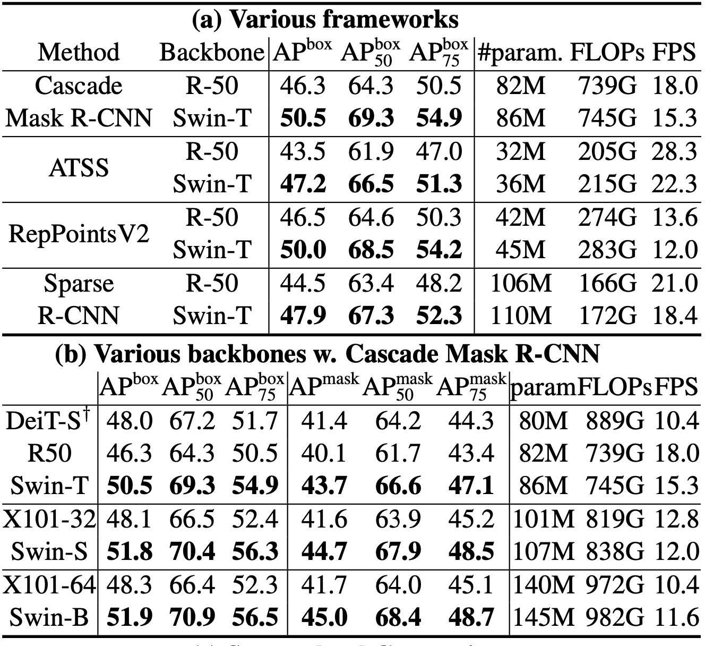
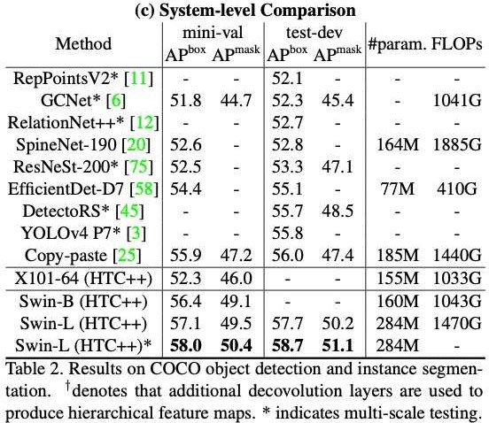
Object Detection Results
Swin Transformer
22
Notes:
Swin-T architecture brings consistent +3.4~4.2 box AP gains over ResNet-50, with slightly larger model size, FLOPs and latency.
Compared with ResNeXt, Swin Transformer achieves a high detection accuracy of 51.9 box AP and 45.0 mask AP, which are significant gains of +3.6 box AP and +3.3 mask AP over ResNeXt101-64×4d, which has similar model size, FLOPs and latency.
The results of Swin-T are +2.5 box AP and +2.3 mask AP higher than DeiT-S with similar model size (86M vs. 80M) and significantly higher inference speed (15.3 FPS vs. 10.4 FPS).
The best model achieves 58.7 box AP and 51.1 mask AP on COCO test-dev, surpassing the previous best results by +2.7 box AP (Copy-paste [26] without external data) and +2.6 mask AP (DetectoRS [46]).

Slide 24
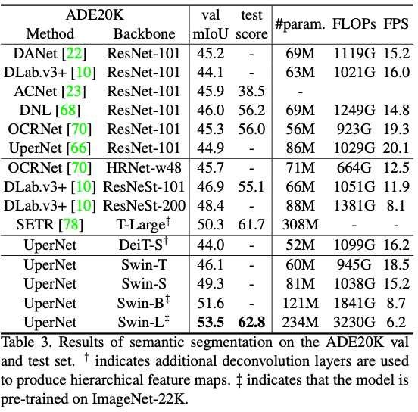
Semantic Segmentation Results
Swin Transformer
23
Notes:
UPerNet is used as the framework.
Swin-S is +5.3 mIoU higher (49.3 vs. 44.0) than DeiT-S with similar computation cost. It is also +4.4 mIoU higher than ResNet-101, and +2.4 mIoU higher than ResNeSt-101.
Swin-L model with ImageNet-22K pre-training achieves 53.5 mIoU on the val set, surpassing the previous best model by +3.2 mIoU (50.3 mIoU by SETR [81] which has a larger model size).

Slide 25
Sources
Original Paper
Paper (https://arxiv.org/pdf/2103.14030.pdf)
GitHub (https://github.com/microsoft/Swin-Transformer)
YouTube
AI Bites (https://www.youtube.com/watch?v=tFYxJZBAbE8)
What's AI (https://www.youtube.com/watch?v=QcCJJOLCeJQ&t=4s)
Blogs
https://arshren.medium.com/swin-transformer-a-unifying-step-between-computer-vision-and-natural-language-processing-3fc0e59ff8f2

